Slide 1


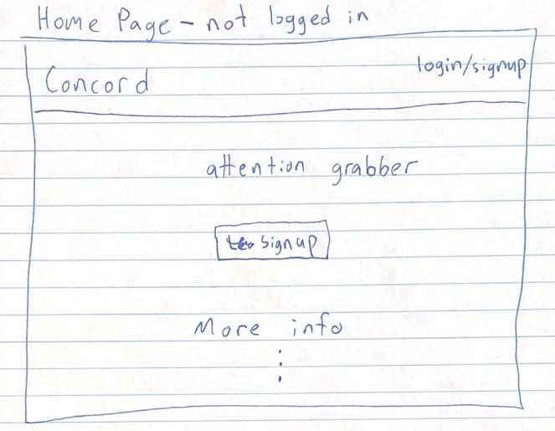
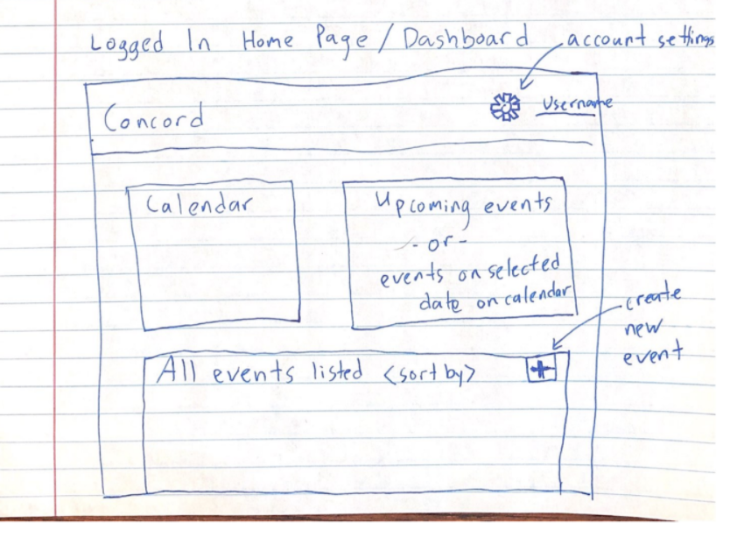
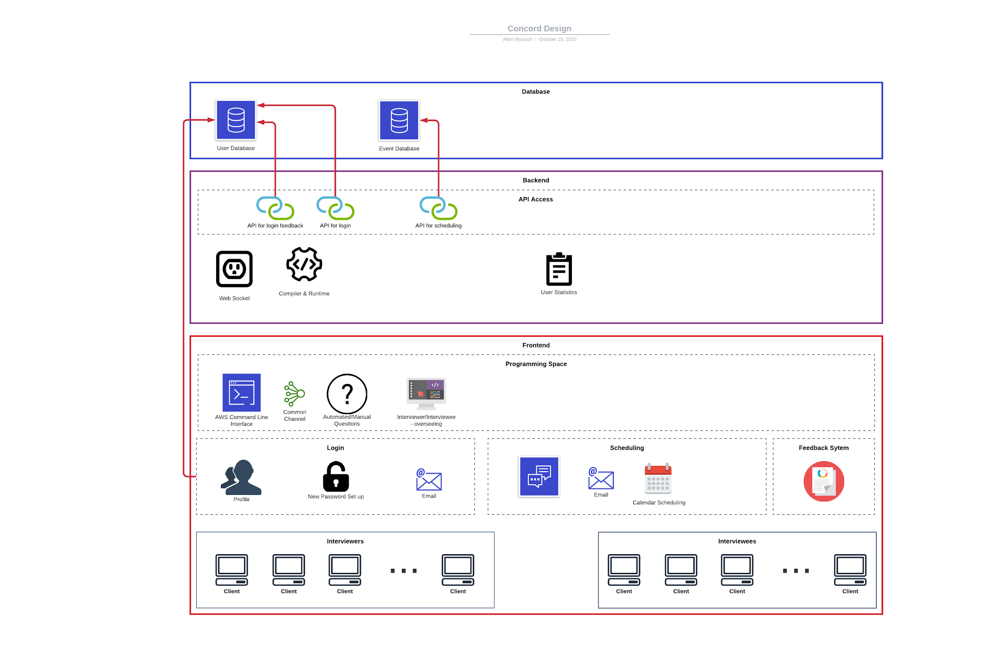
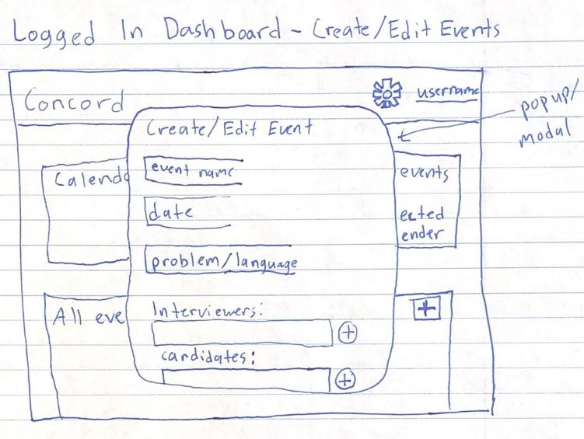
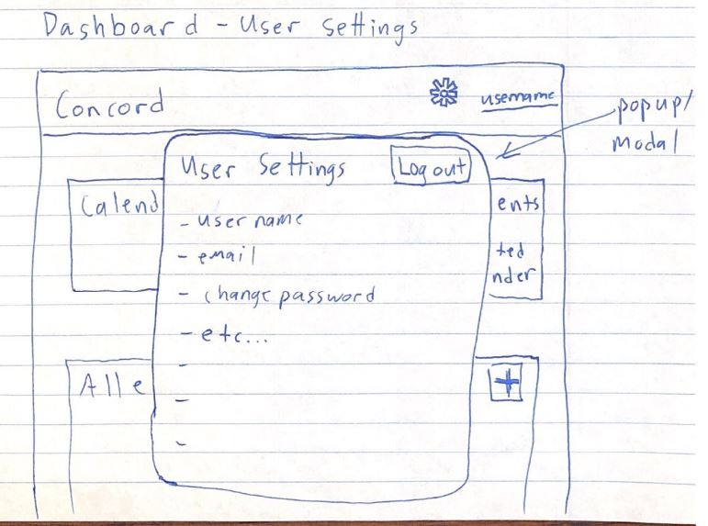
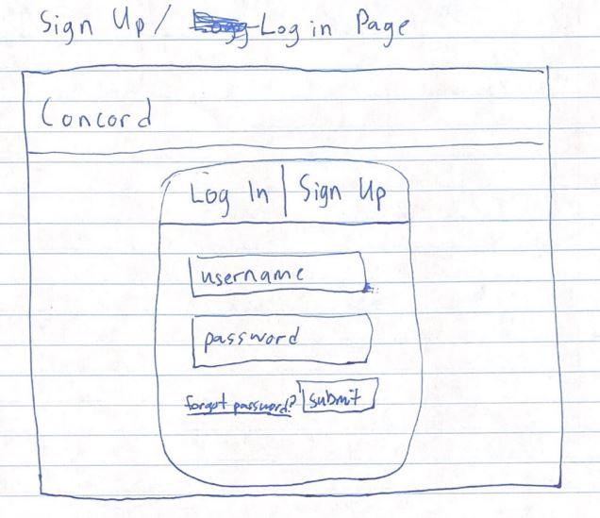
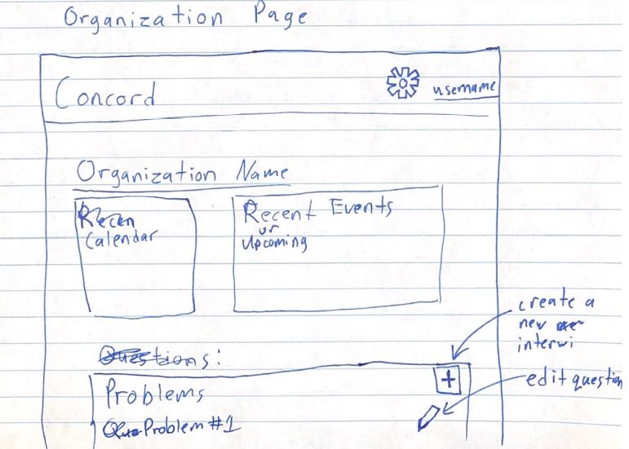
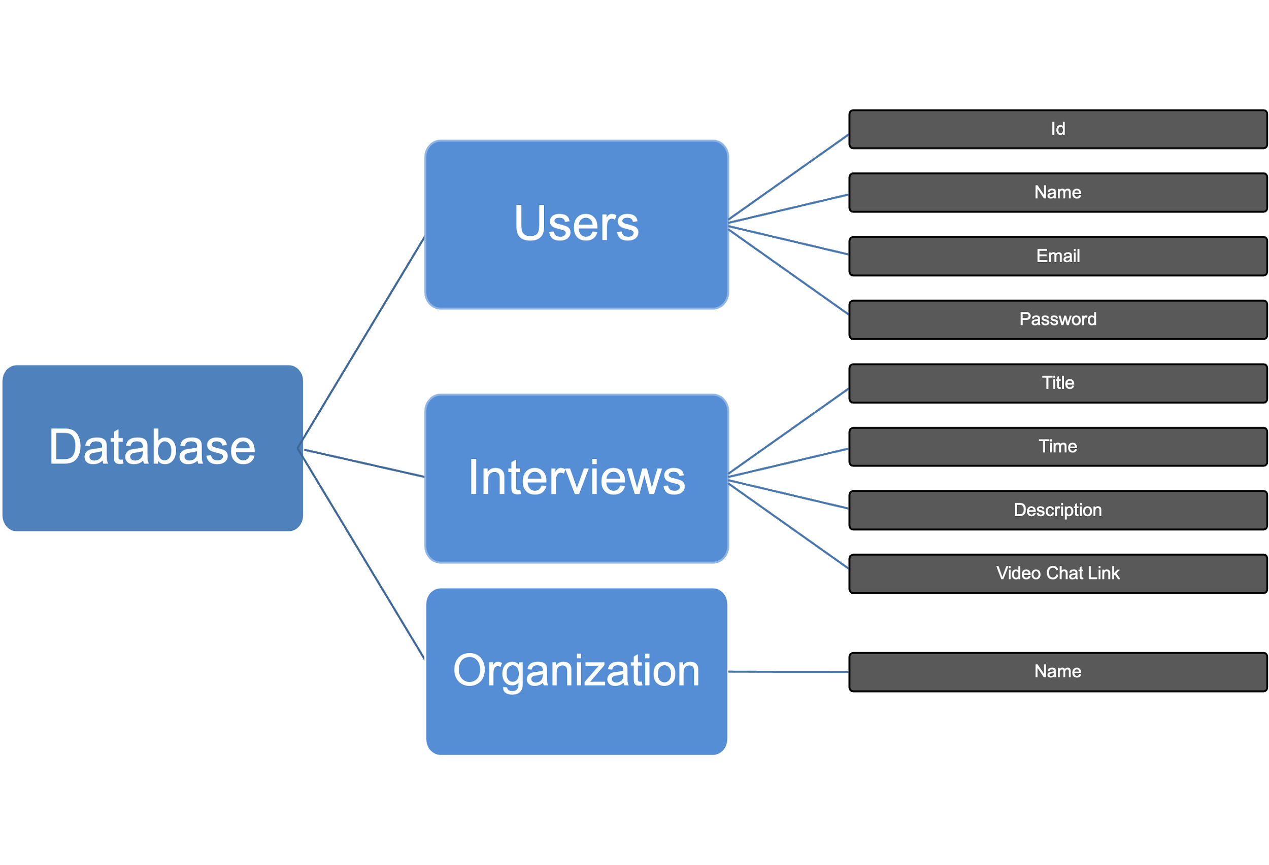
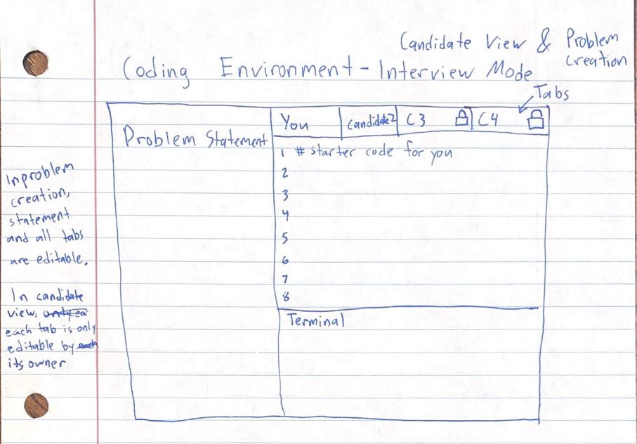
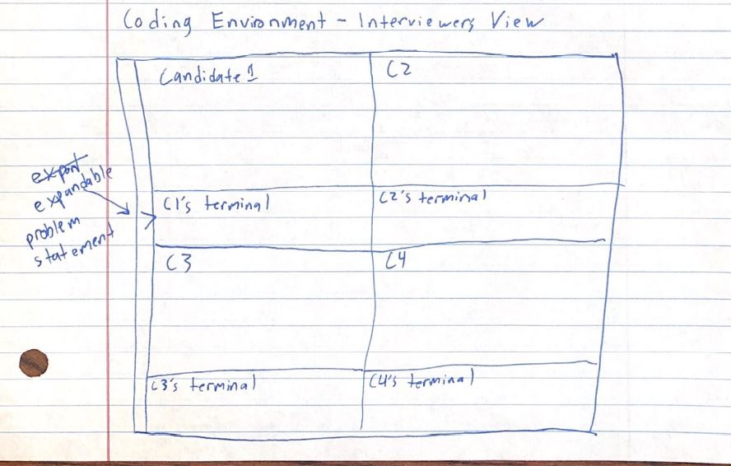
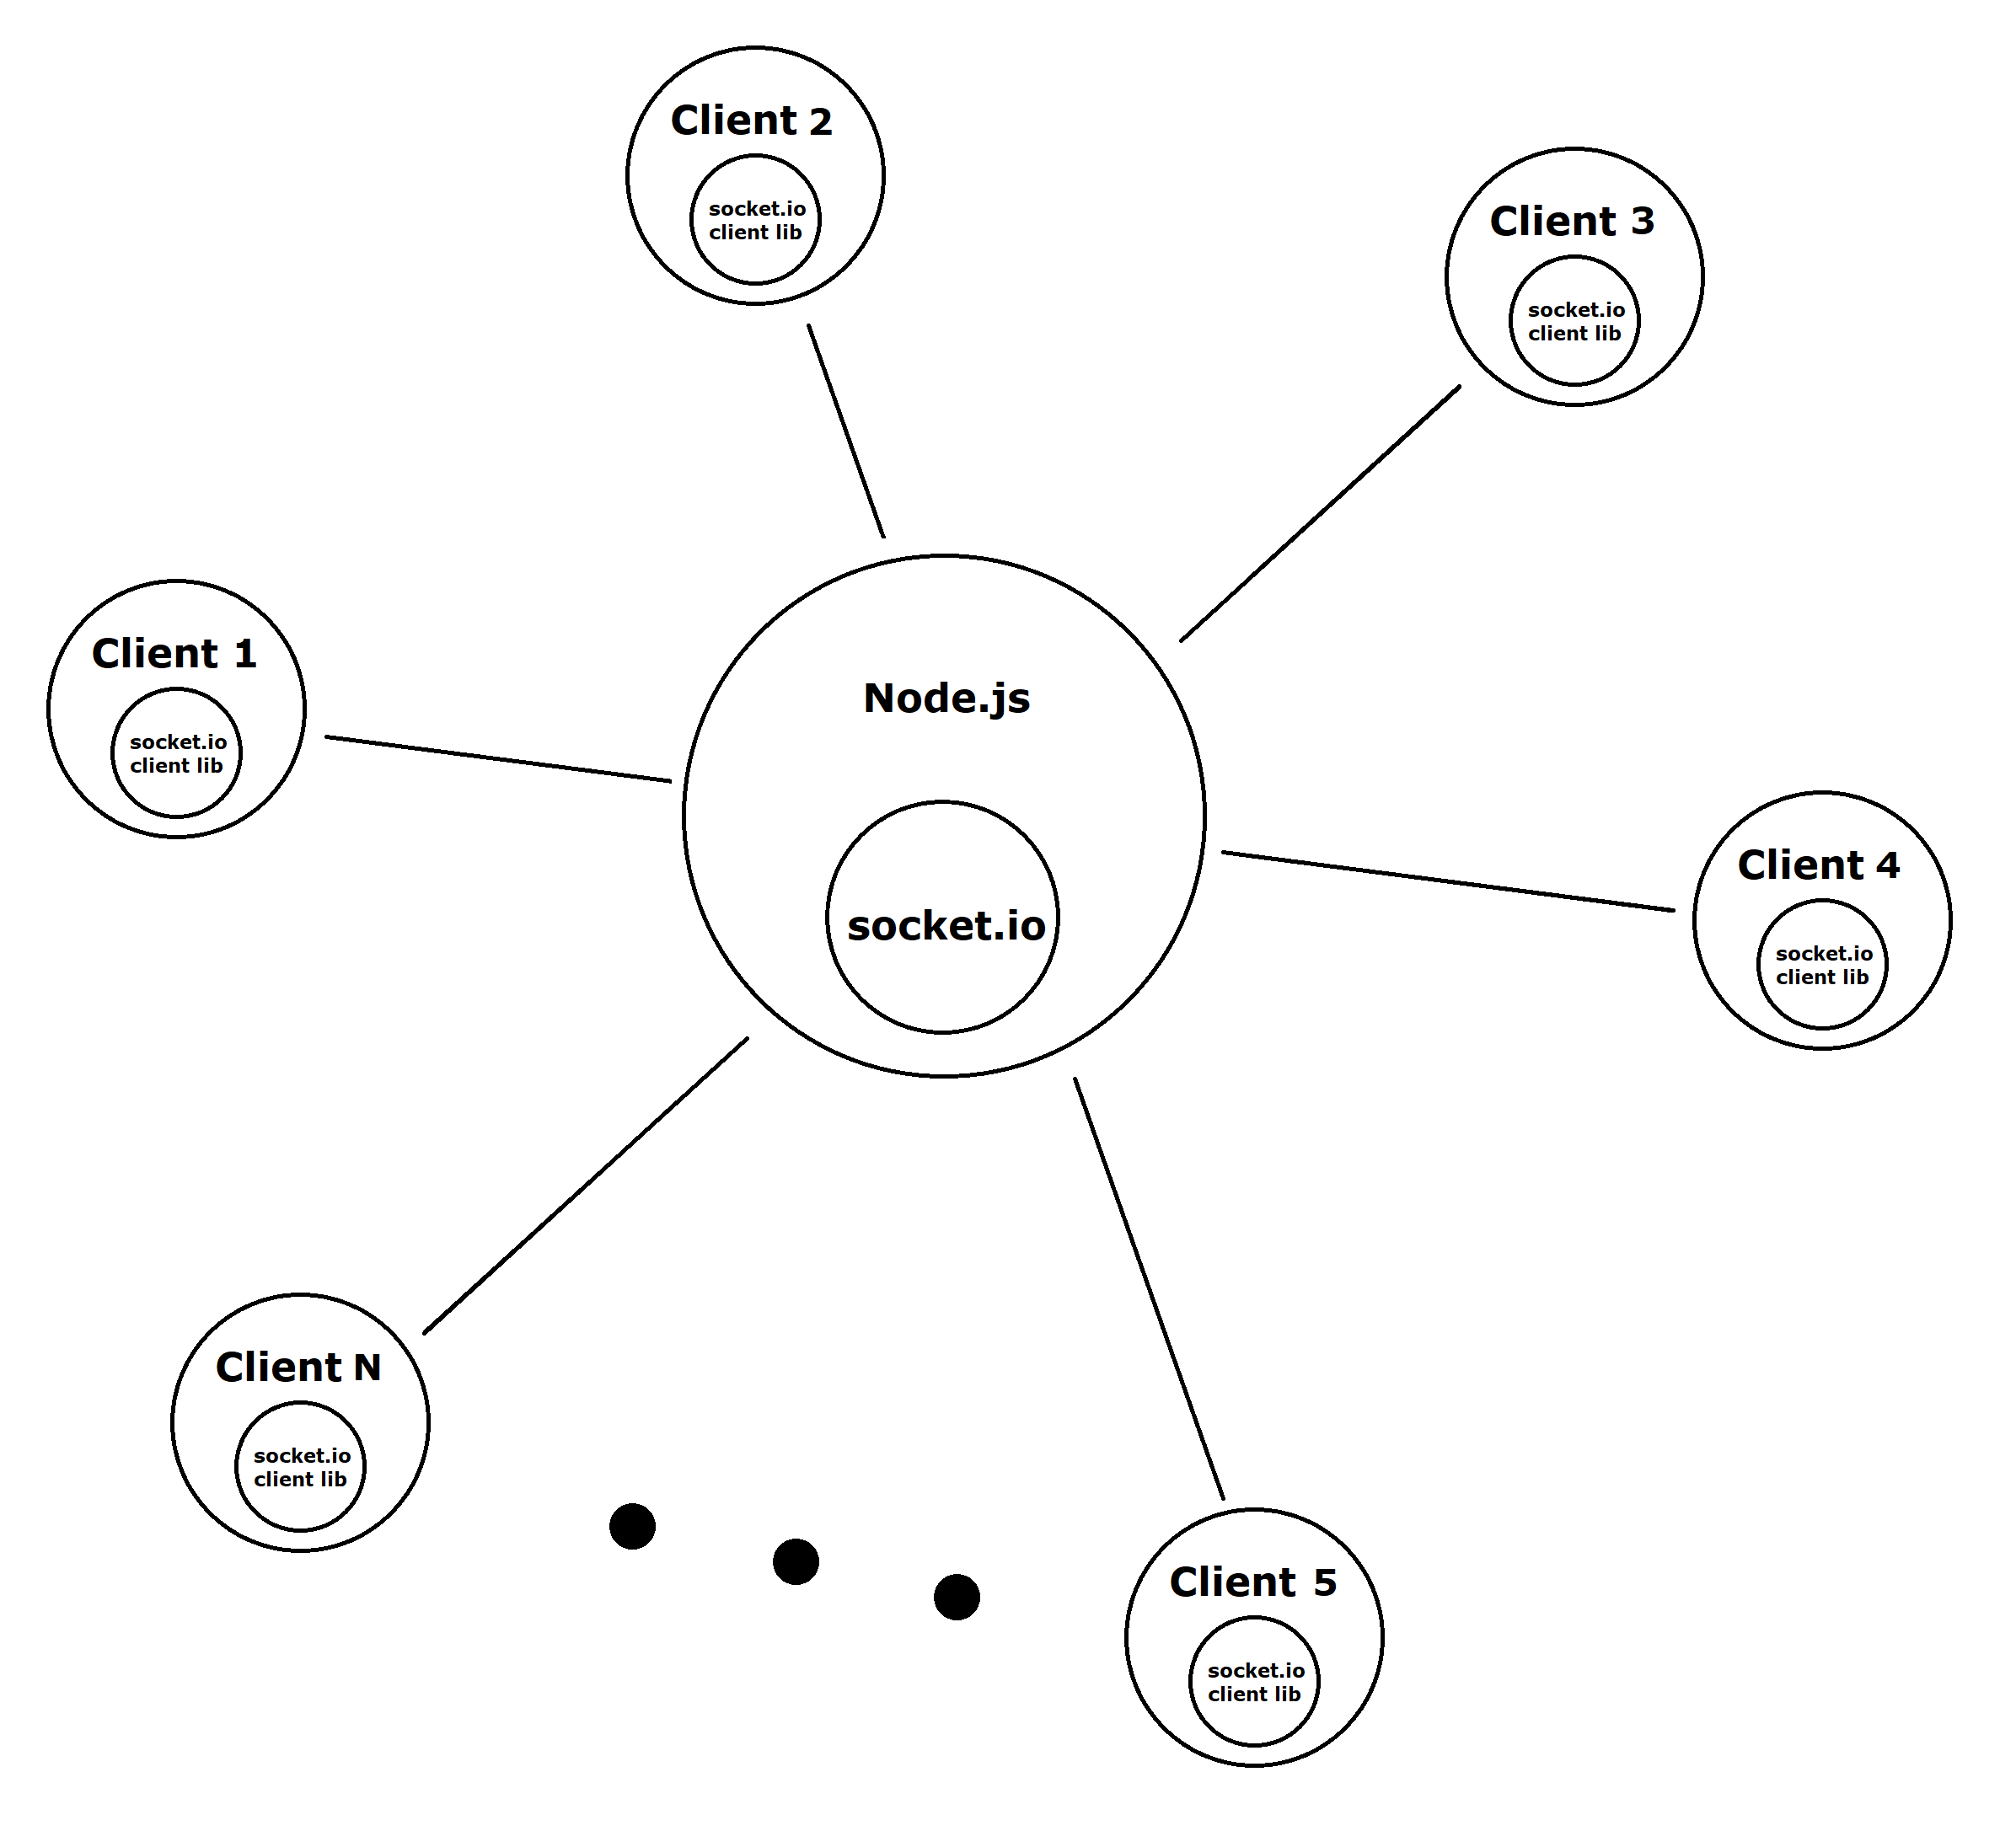
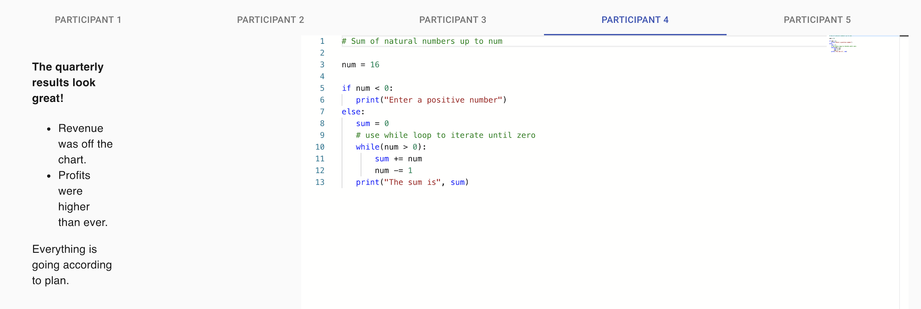
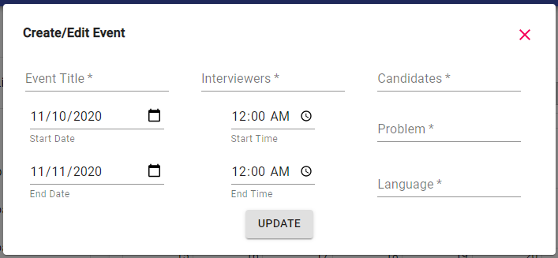
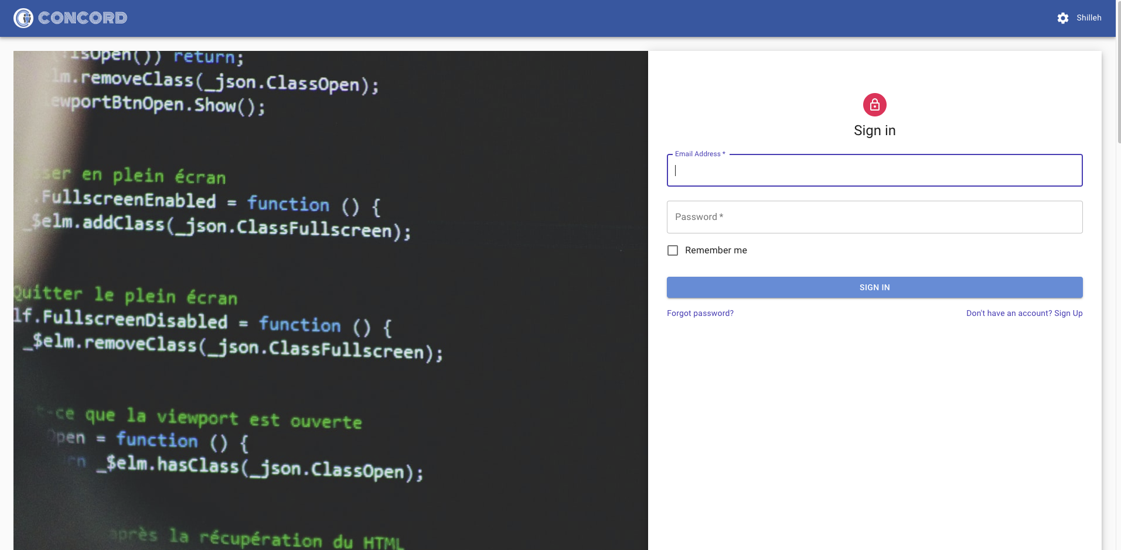
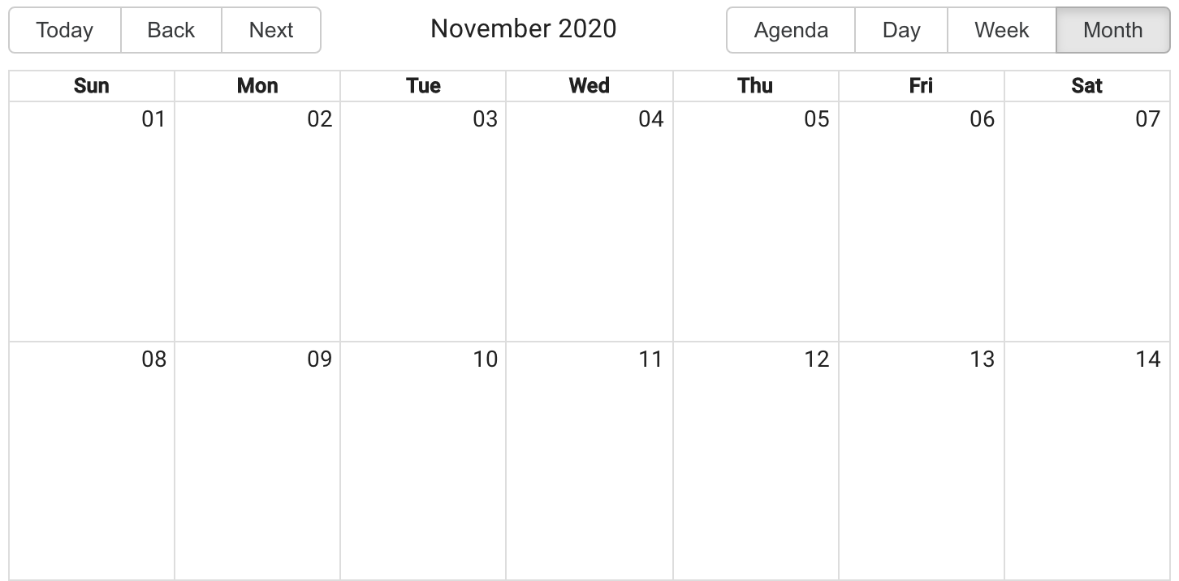
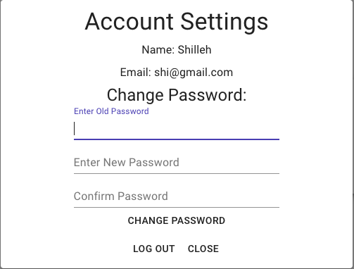
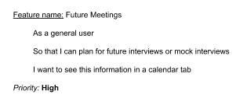
Concord: Interviewing Simplified
Trevor Bolton, Mahmood Shilleh, Peiman Mohseni, Qusai Amer,
Gowtham Batchala, Albin Kyle Myscich
Dept. of Computer Science and Engineering, Texas A&M University
System Architecture
Entity Design/DB Management
Concord system architecture follows three-tier architecture that include:
Presentation Tier
This tier is initially developed by the Lo-fi sketches based on the user stories. Our application uses React with Material UI to build this.
Logic Tier
This tier contains all the logic to run all the application’s capabilities. It is developed using Typescript and React.
Persistence Tier
This tier comprises of the database and data access layer which move data to the logic tier. Concord uses a Postgres database that is run by GraphQL.
Concord uses a PostgreSQL database that is being managed by GraphQL API and TypeORM. Once all the queries and mutations are validated in the GraphQL Playground, they are utilized in the front-end via the Apollo Server. The main tables in the database include:
Users
The users table consists of user-related information stored in the columns such as id, name, and email.
Events
The interviews table include the title, time, and video link of the interview. It also contains relations with the users table that specify users that participate in this interview.
Organizations
This table contains the name of the organization using Concord.
Design Diagram
Lo-fi Sketches
Database Entity Diagram
Event Scheduling
User Interactions
Calendar and Event Scheduling:
Past events
Keeps a register of the finished events.
Invite others
The option allows the Interviewers and candidates to add their details.
Add future events
Event planning for feature coding sessions involving a specified: start and end dates/times, users, problem, language, and programming languages.
User Interactions with Each Other:
Multi-User IDE:
Users doing a coding interview can view information in other ideas, whilst incorporating secure websockets.
User Interactions with Concord:
Login/Signup:
Users can create an account and sign in.
Forgot Password
Users can create a new password with a valid email if they forget theirs.
Settings
Information can be viewed and edited in this modal.
Contact Us
Concordnoreply@gmail.com can be contacted on the homepage regarding any feedback!
Home Page
Shows general information about us and other miscellaneous things.
Websocket Diagram
Multi-User IDE
Calendar Event Entry
Home Page/Sign in
Calendar Dashboard
Settings Modal
Testing and Validation
Measuring the Agile Process
Customer Feedback
BDD and User Story Guidance: BDD process was mostly done by Puppeteer, which is used for high level controlling of Chrome or Chromium.
SMART user stories: All of the user stories are relevant and comply with the characteristics of a SMART (Specific, Measurable, Achievable, Relevant, and Timeboxed). Here is an example of a story we write that is specific, achievable, and relevant.
GitHub: Concord project management is done using the GitHub project tool. This tool improves the structure of the software and makes it maintainable. It helps assign issues and keep track of the team’s progress in our project. Once an issue is complete, it makes it really easy to review it and merge it to the master branch. The contribution of the team over time can be measured with this tool.
Pivotal Tracker: Concord team also used Pivotal Tracker but was not as emphasized as GitHub; it was used for some user stories however.
Feedback: The customer provided a variety of suggestions including applying websocket safety and security measures, using Role-based access control (RBAC) and integrating hierarchical promotion of testing as per common practice. In addition, providing forgot password feature was suggested. The customer stressed the high priority IDE.
Improvements: The IDE was implemented in this final iteration as suggested, as well as the forgot password feature. However, improvements can be made to the IDE such as a Chat Box, Split Screen IDE, and creating a join room to access a coding event.
Future Meetings User Story

